Slide 1



Slide 2



Who we are
Vision
Regional and international leardership in the field of HRM
Mission
Enhance the work environment and managing employees, Who are the most important assets of your organization with effeciency and effectiveness

Slide 3

Our Team
Naira Lotfy
Mohammed Abdelrahman
HR Manager
Ahmed Samir
Hossam Mostafa
Ahmed Sameh
Marketing Manager
HR Consaltants

Slide 4

Cons of traditional HRM Processes
Time consuming & Inefficient processes
Lack of Automation
Limited data & Reporting capabilities
Inflexbility
Subjective Decision-Making
Higher Costs

Slide 5

Key features of Oracle ERP System
Security and Data protection
User-friendly interface
Employee self-service
Allowing users to register and navigate with ease
only authorized users can interact with sensitive information.
Access and manage their own information
Customization options
Payroll Management
Compliance with Labor Laws
To match your needs and your organization policy
Automated Payroll calculations
Regulatory updates

Slide 6


Slide 7
Managing and developing the Personnel department
Collection of all necessary recruitment requirements, Dealing with social insurance & Labor office
Providing the technical support to use the application effectively
Creation and management of employment contracts of all kinds
Oracle staff training
Providing accurate reports to support decision-making
Setup an HR system for your organization on Oracle

Slide 8
Our Services
Managing and developing the Personnel department
Collection of all necessary recruitment requirements, Dealing with social insurance & Labor office
Providing the technical support to use the application effectively
Creation and management of employment contracts of all kinds
Oracle staff training
Setup an HR system for your organization on Oracle
Providing accurate reports to support decision-making

Slide 9
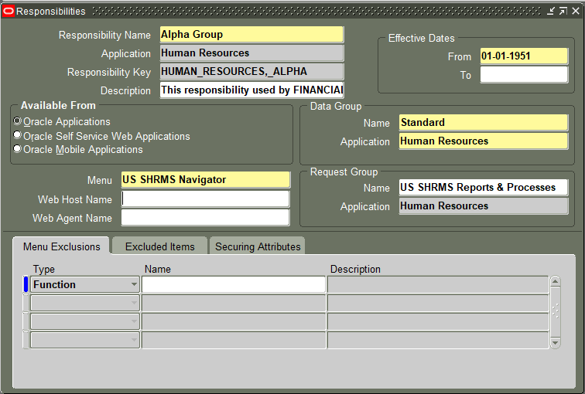
Examples of our work

Slide 10
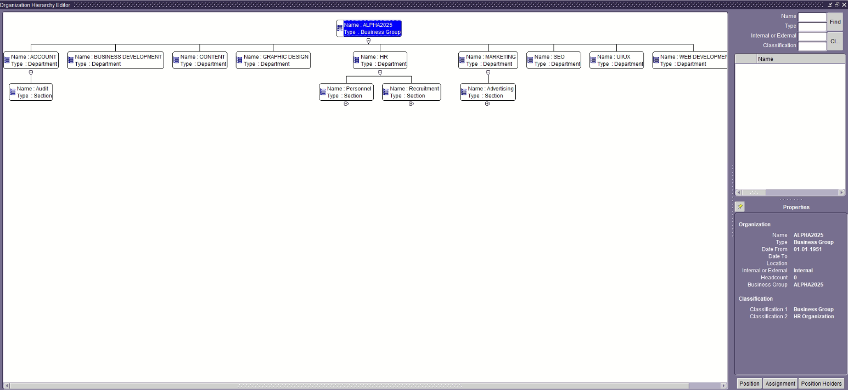

Slide 11
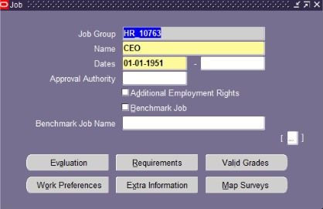

Slide 12
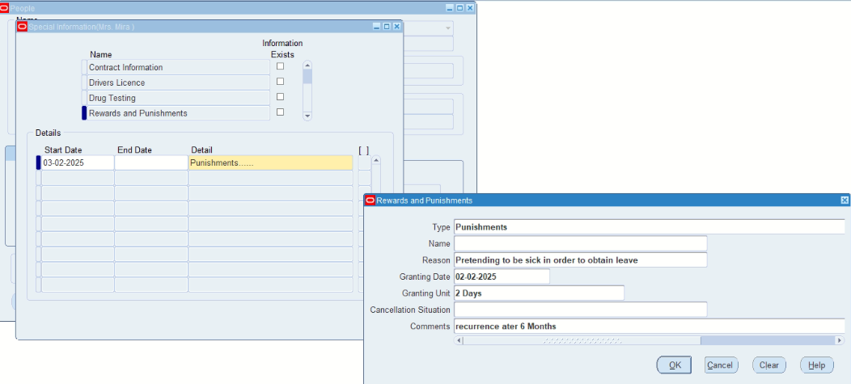

Slide 13
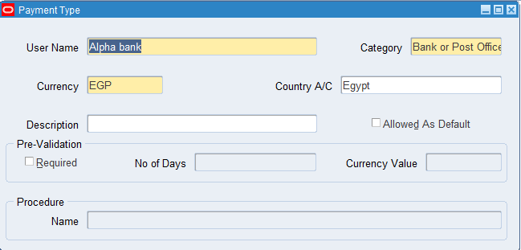

Slide 14
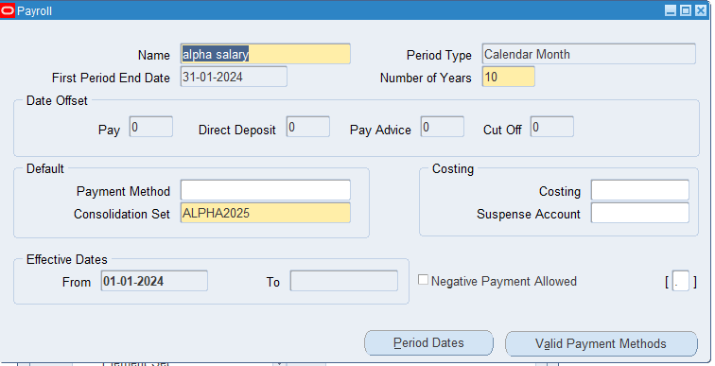

Slide 15
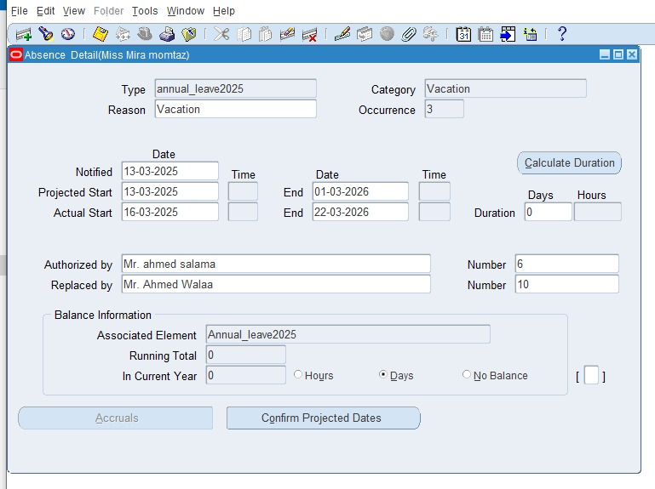

Slide 16
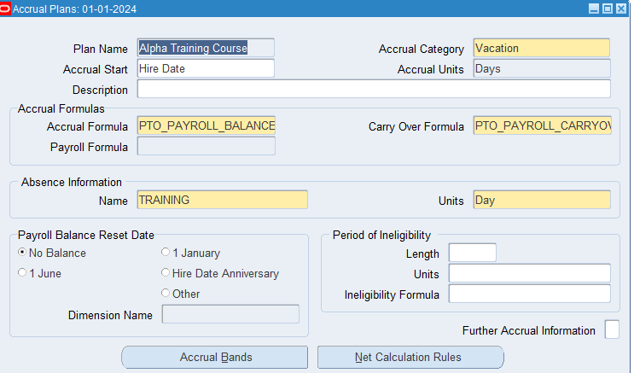

Slide 17
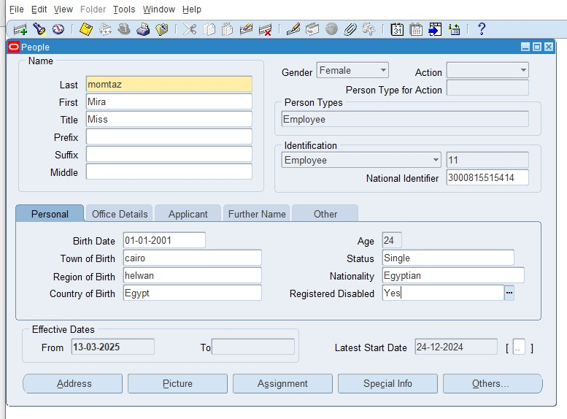

Slide 18
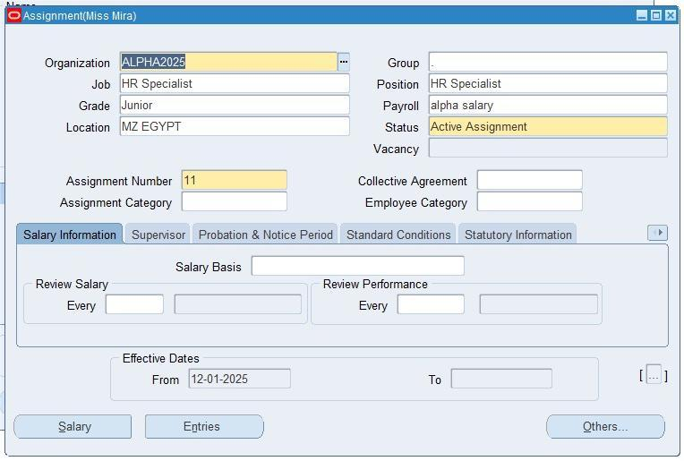

Slide 19



Thank you
Contact with us
https://www.linkedin.com/in/alpha-group-67890
https://www.facebook.com/AlphaGroup.Official
https://www.alphagroup@gmail.com

Slide 20


